Slide 1
DELUXE STORE: BUSINESS INTELLIGENCE AND PERFORMANCE INVESTIGATION
EXECUTIVE PRESENTATION AND DEFENCE
OLABODE DORCAS | TECHACCESS FOUNDATION | DEBBYLYTICS DATA ANALYTICS PROGRAMME
IN CELEBRATION OF ACTRESS KATE HENSHAW’S BIRTHDAY
Notes:
Introduce yourself and the project: an independent investigation of the Deluxe Store sales dataset, built in Power BI.

Slide 2
THE CLIENT'S BRIEF AND MY APPROACH
Consistency
Contribution
Discounting
Is sales performance steady over time?
Which products, regions and segments drive profit?
Does it support or weaken results?
How I investigated
1. Check data quality
2. Prepare and model
3. Build Power BI dashboard
4. Analyse and recommend
BUSINESS INSIGHT
RECOMMENDATION
The owner needs to know what drives profit, not only how much was sold. Three questions frame the whole investigation.
Use the dashboard filters for region, category, segment and date to answer the owner's follow-up questions live.
Dashboard pages: sales overview, product profitability, regional and team performance, discount and shipping
Notes:
The owner wants an investigation, not just totals. I organised the work around three questions and four steps.

Slide 3
DATA QUALITY AND PREPARATION
9,994 to 9,993
1 fact + 6 dimensions
Rows before and after cleaning
Tables built in Excel, loaded with Power Query
Issue found | Decision | Reason
One exact duplicate row | Removed | Avoids double-counting sales
Repeated Order IDs | Kept | One order holds several product lines
Postal Code | Stored as text | A label, not a number to add up
BUSINESS INSIGHT
RECOMMENDATION
Cleaning removed only one duplicate row, so the results rest on almost all of the original records.
Record each data check and decision whenever the data is refreshed, so future results stay comparable.
Notes:
Be ready to defend each decision. Duplicate: exact match on every column. Repeated Order IDs are legitimate line items.

Slide 4
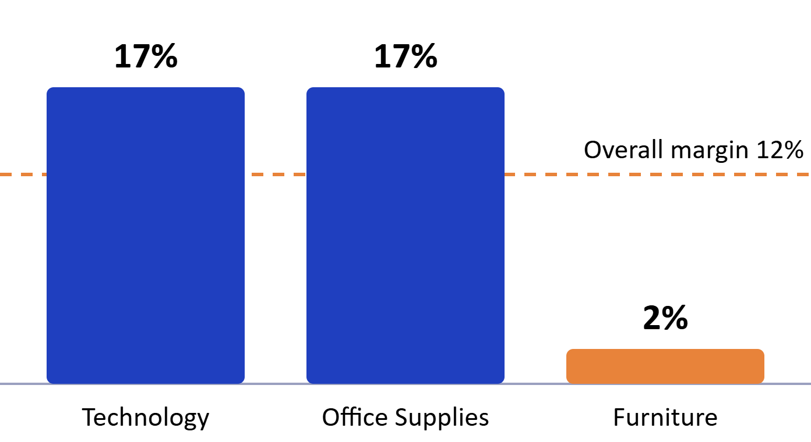
DELUXE STORE: SALES PERFORMANCE INSIGHTS
Individual capstone | Olabode Dorcas | TechAccess Foundation
₦2,297,200.86
₦286,397.02
5,009
12%
Total revenue
Total profit
Total orders
Profit margin
Profit margin by product category
Furniture is the weak spot
₦742,000.00 in sales but only a 2% margin, against 17% for Technology and Office Supplies.
BUSINESS INSIGHT
RECOMMENDATION
A 12% margin means the store keeps about ₦12 profit for every ₦100 of sales, and Furniture sits far below that.
Track margin, not just revenue, as the main monthly measure of performance.
Notes:
Opening: This project analyses Deluxe Store sales to find where profit is made and lost. Headline: ₦2,297,200.86 revenue, ₦286,397.02 profit, 5,009 orders, a 12% margin. Finding 1: West and East drive the business; South is the smallest region. Finding 2 (the chart): Technology and Office Supplies earn 17% margins, but Furniture earns only 2% despite ₦742,000.00 in sales. Finding 3: as discount rates rise, profit falls, and very high discounts lose money. Close with the recommendation: cap deep discounts, reprice Furniture, grow West and East. Invite questions.

Slide 5
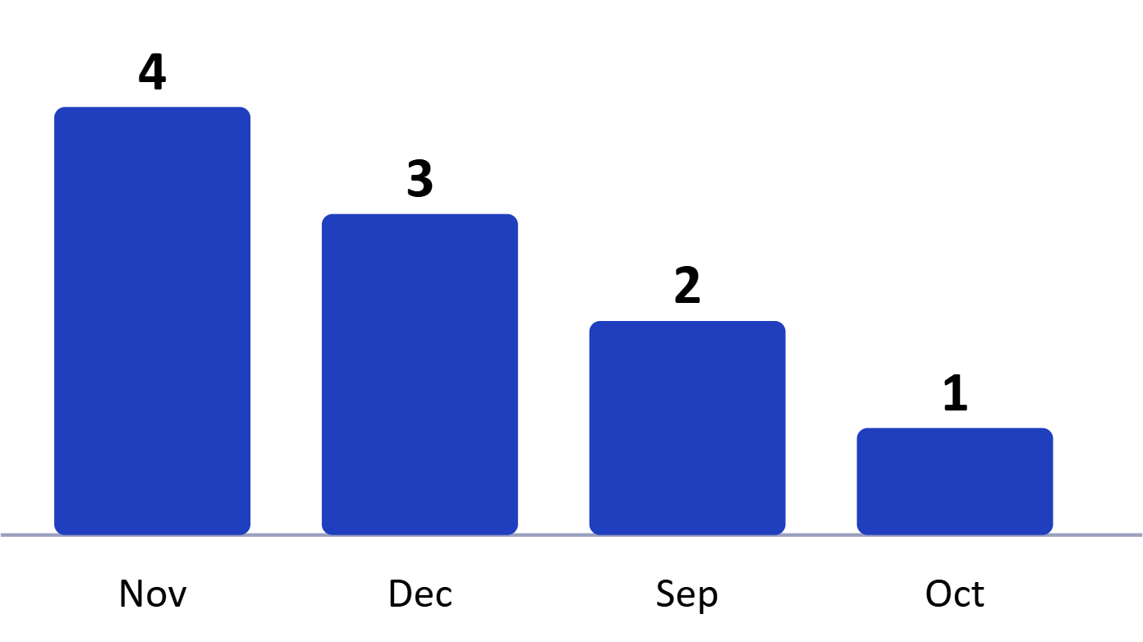
SALES OVER TIME: A YEAR-END PATTERN
Top 10 revenue months, by calendar month
Fact
All 10 highest-revenue months fall between September and December. November 2017 is the peak.
Fact
Monthly revenue is volatile, with sharp spikes rather than a steady climb.
BUSINESS INSIGHT
RECOMMENDATION
Revenue is uneven. All 10 strongest months fall between September and December.
Plan stock, staffing and promotions ahead of September to December, and look into why other months run lower.
Notes:
Answers the client's first question: performance is not consistent. It peaks at year-end.

Slide 6
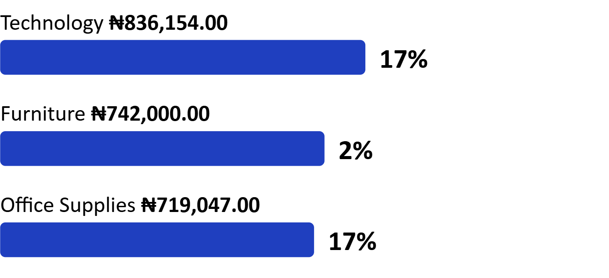
STRONG SALES DO NOT ALWAYS MEAN STRONG PROFIT
Revenue and profit margin by category
Furniture
Second in revenue, yet the margin is only 2%.
Technology
Highest revenue and a 17% margin.
Top product
Canon imageCLASS 2200 Advanced Copier leads on both revenue and profit.
BUSINESS INSIGHT
RECOMMENDATION
Furniture brings in ₦742,000.00 in sales but only a 2% margin, so high sales are not turning into profit there.
Review Furniture costs, pricing and discounts before pushing more volume, and protect the 17% margins in Technology and Office Supplies.
Notes:
Answers the second question: strong sales do not always translate into strong profit, as Furniture shows. Margin is profit divided by revenue.

Slide 7
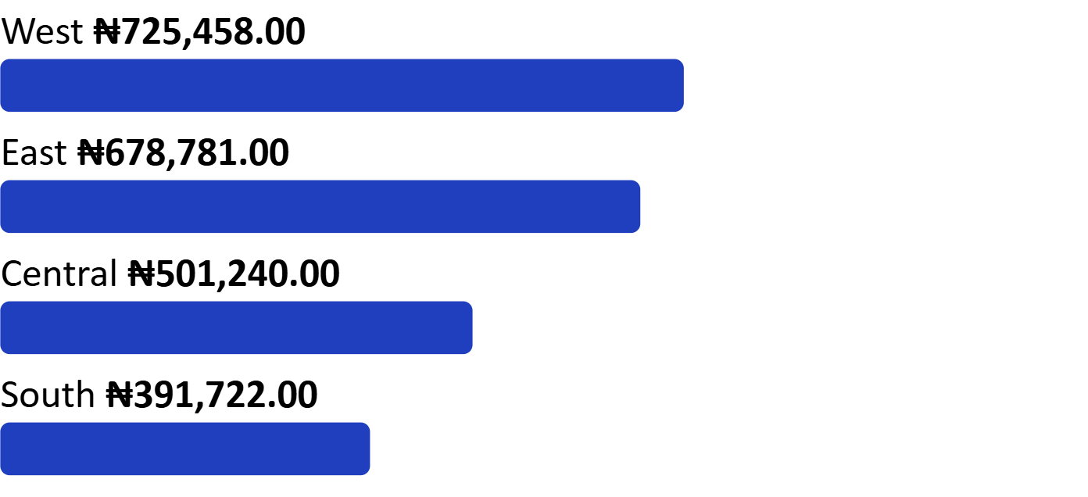
REGIONS AND CUSTOMER SEGMENTS
Revenue by region
West and East lead
They rank first and second on both revenue and profit.
South versus Central
South sells less than Central but ranks above it on profit.
Segments
Consumer is the largest segment, then Corporate, then Home Office.
BUSINESS INSIGHT
RECOMMENDATION
West and East lead on revenue and profit. South earns less revenue than Central yet ranks above it on profit.
Study what works in West and East, and find out why Central turns sales into less profit.
Notes:
Region profit ranking: West, East, South, Central, read from the regional profit chart.

Slide 8
DISCOUNTING AND SHIPPING
Discounts
Shipping
16%
About 14%
Average discount across 5,009 orders
First Class margin, the highest of the four modes
Orders with no discount bring the most revenue and profit.
Standard Class carries most of the revenue.
Profit margin falls steadily as the discount rate rises.
Margins sit in a narrow band of roughly 12% to 14% across modes.
The very high discount band records negative profit.
Same Day is the smallest mode by revenue.
BUSINESS INSIGHT
RECOMMENDATION
Margin falls as discounts rise, and the very high discount band records negative profit. The data shows the link, not the cause.
Set a ceiling on discounts and review very high discount orders. Ask why Standard Class earns less margin than First Class.
Notes:
Answers the third question. Say clearly: discounts and lower profit move together in this data. The data does not prove discounts caused it.

Slide 9
SALES REPRESENTATIVE PERFORMANCE
Revenue ranking, top 10
Fact
Organic
Morris Garcia
Stella Given
Abigail Thompson
Sheila Stones
Steve Pepple
Anne Wu
Alan Ray
Mary Gerrard
Thompson Crawford
Organic is far ahead of every named rep on revenue.
Fact
Among named reps, Morris Garcia ranks first and the gap to the rest is small.
Read with care
Organic is a group in the data, not a named person. Its meaning needs confirming before judging rep performance.
BUSINESS INSIGHT
RECOMMENDATION
Organic revenue is far above any named rep, so rep performance cannot be judged from names alone.
Confirm what Organic means in the data, then rank reps on profit as well as revenue.
Notes:
Organic is not a person. Say that the data does not explain it, so conclusions about individual reps are limited.

Slide 10
RECOMMENDATIONS
1. Review deep discounts
2. Re-examine Furniture
Evidence: margin falls as discounts rise, and the very high band records negative profit.
Evidence: 2% margin against 17% for Technology and Office Supplies.
3. Build on West and East
4. Plan for September to December
Evidence: they lead on revenue and profit. Look into why South and Central lag.
Evidence: all 10 top revenue months fall in this window.
5. Start with discount limits and Furniture pricing
Evidence: they address the clearest margin gaps.
Notes:
Keep each recommendation tied to evidence. Suggest, do not overclaim.

